Slide 1
冒險故事 (animaze)
(OOC警告)

Slide 2

1.目標
Notes:
https://unsplash.com/photos/a-close-up-of-a-dart-with-a-card-on-it-Ai0HaqLdhSA

Slide 3
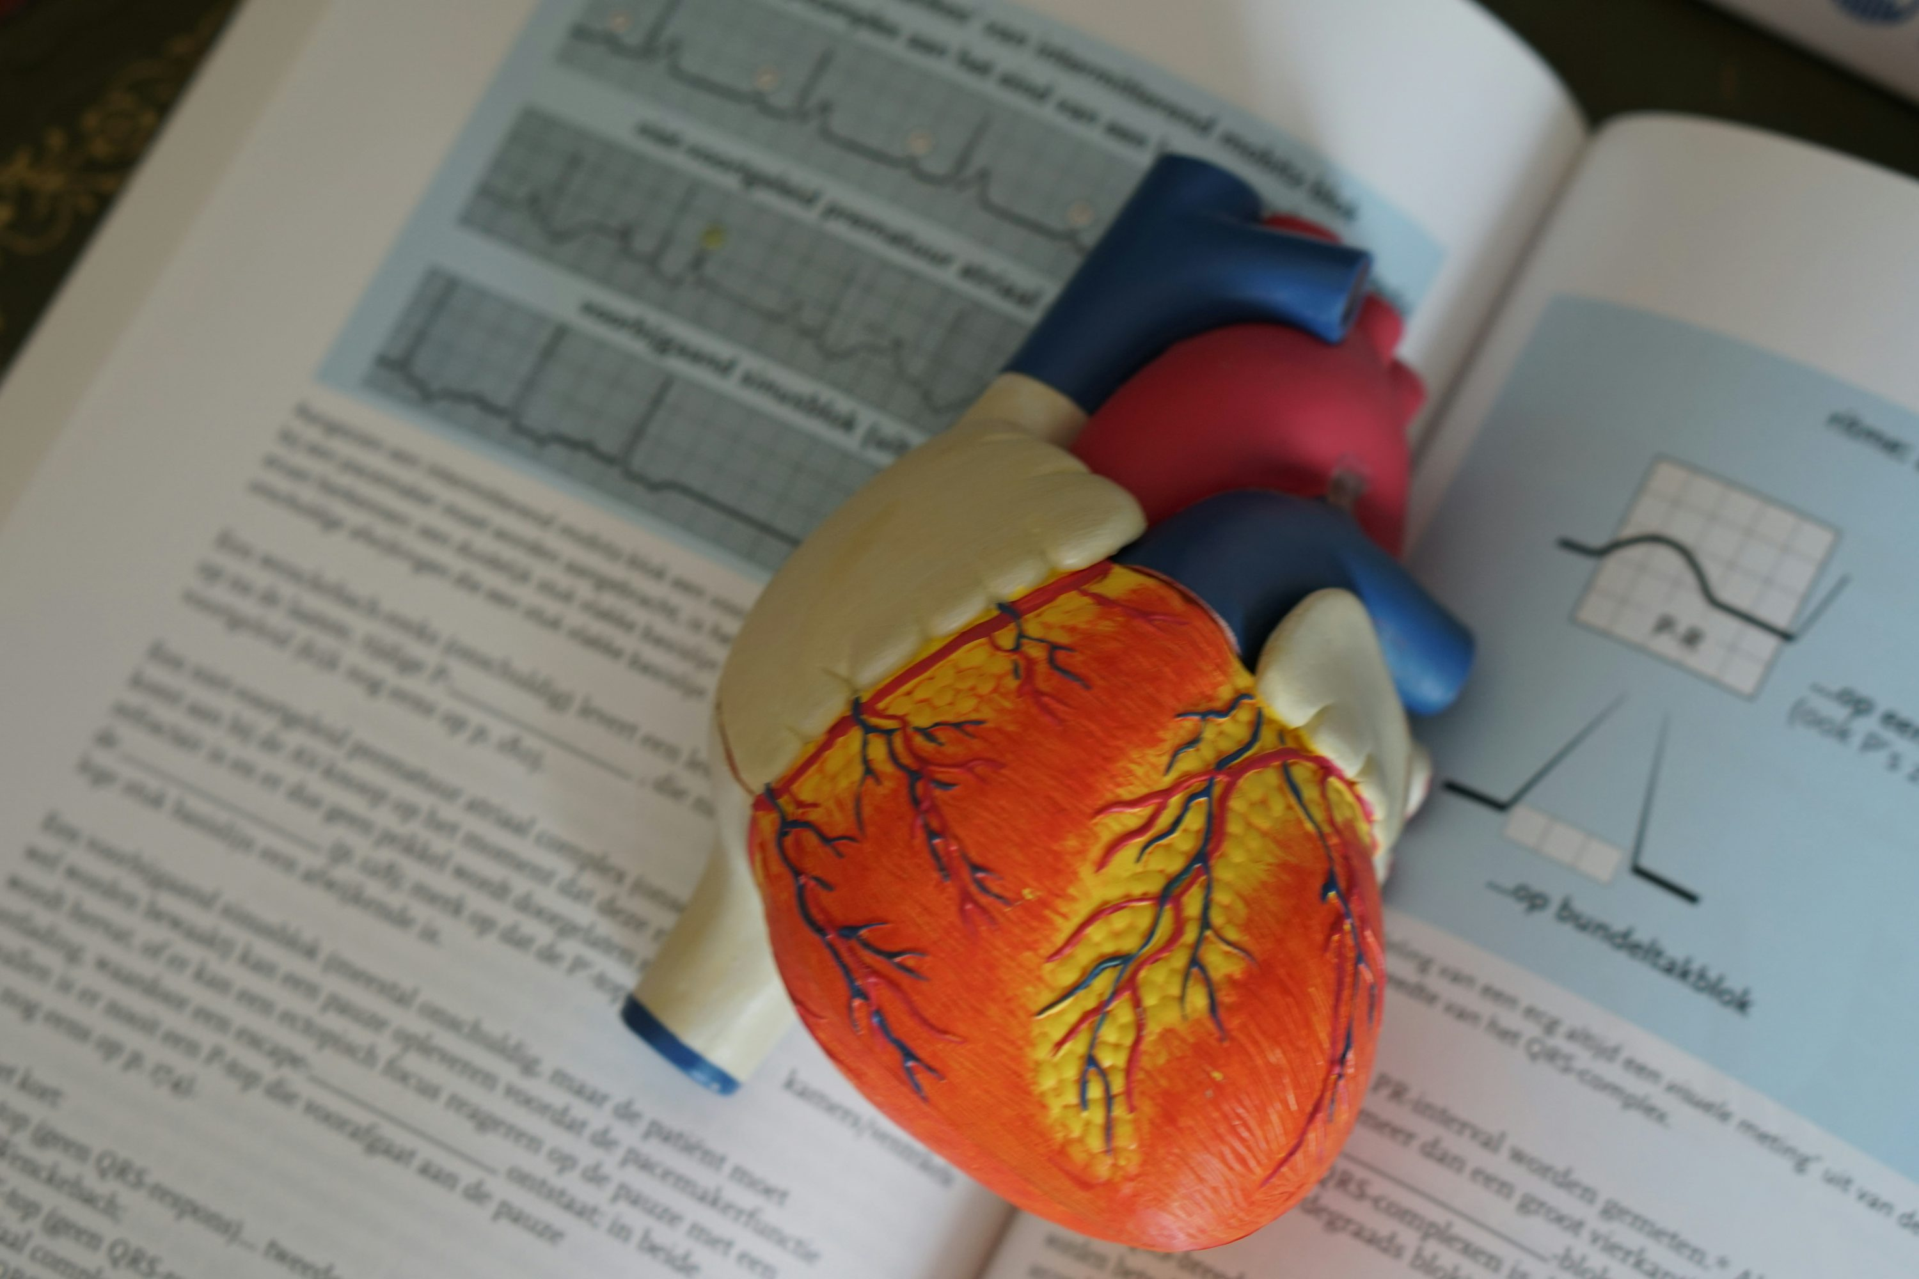
Notes:
https://unsplash.com/photos/human-heart-illustration-z8_-Fmfz06c
唸完四年的書，

Slide 4

Notes:
https://unsplash.com/photos/a-woman-in-a-white-lab-coat-writing-on-a-notebook-0X-1-9lpEbM
我的目標是成為一名能獨當一面、面對任何挑戰都能解決的實習醫師

Slide 5
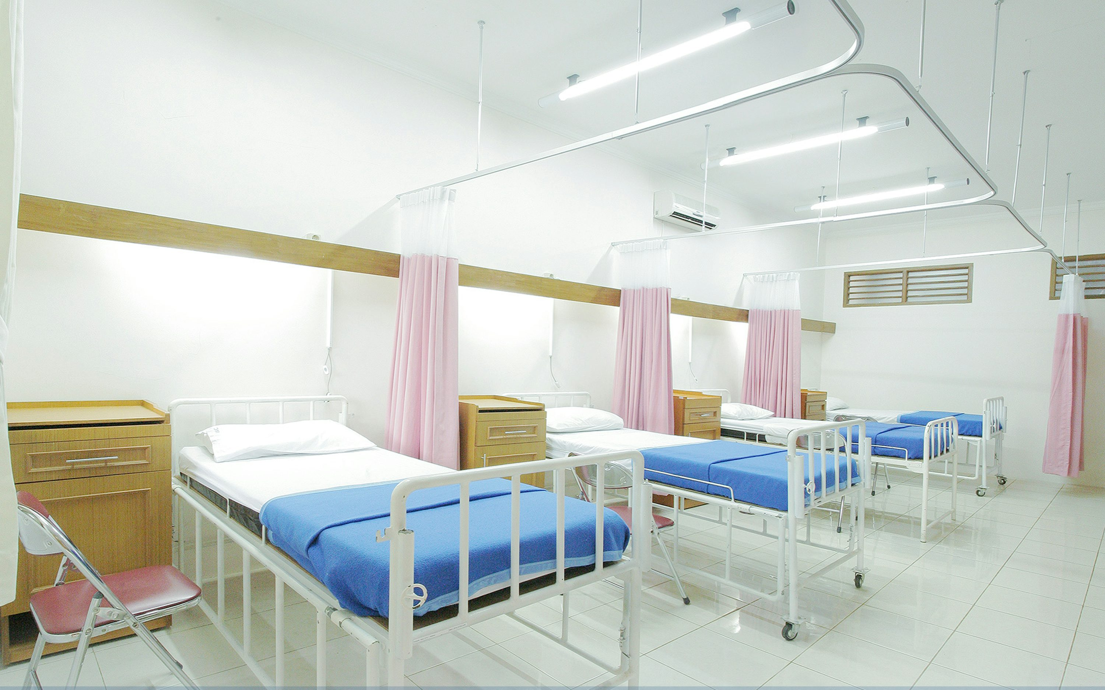
Notes:
https://unsplash.com/photos/empty-hospital-bed-inside-room-zbpgmGe27p8
懷著既緊張又期待的心情，我被分配到急診室實習

Slide 6
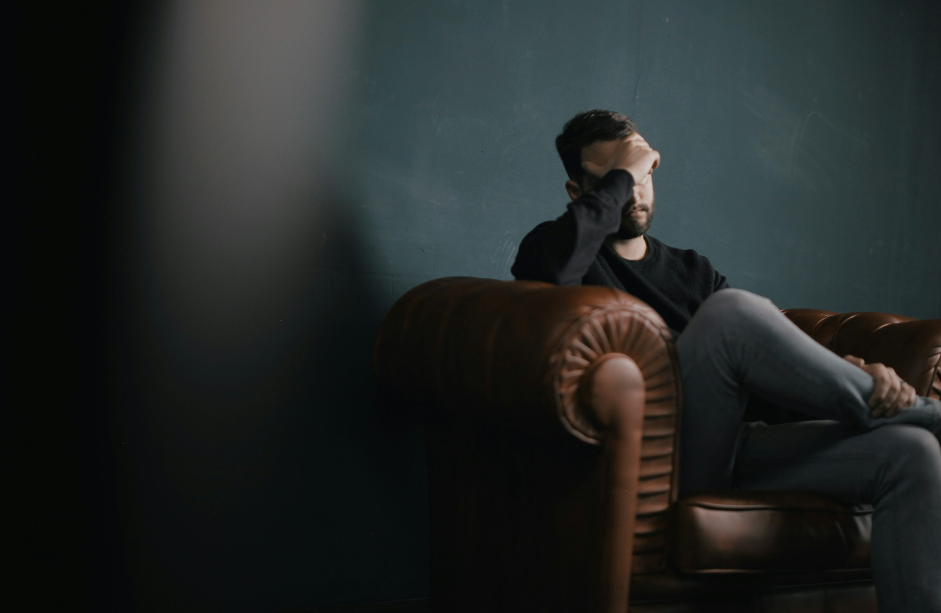
2.阻礙
Notes:
https://unsplash.com/photos/a-man-holds-his-head-while-sitting-on-a-sofa-BuNWp1bL0nc

Slide 7
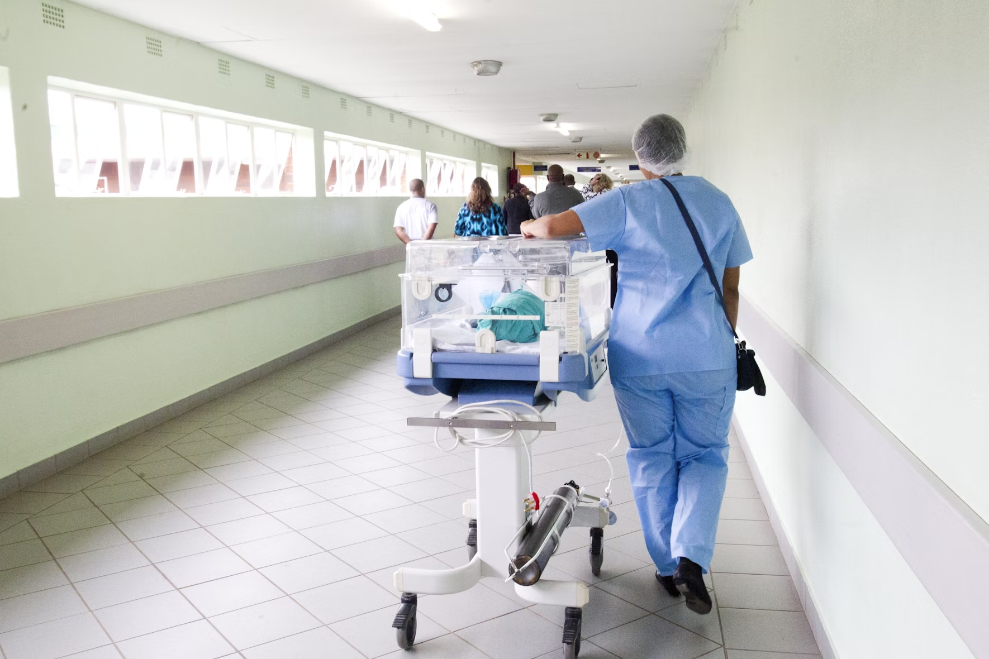
Notes:
https://unsplash.com/photos/person-walking-on-hallway-in-blue-scrub-suit-near-incubator-ZCO_5Y29s8k
面對急診室來來往往的人群

Slide 8

Notes:
https://unsplash.com/photos/group-of-doctors-standing-on-conference-front-view-portrait-of-medical-team-KTwmrDddkUY
看著前輩們自信又俐落的樣子，

Slide 9
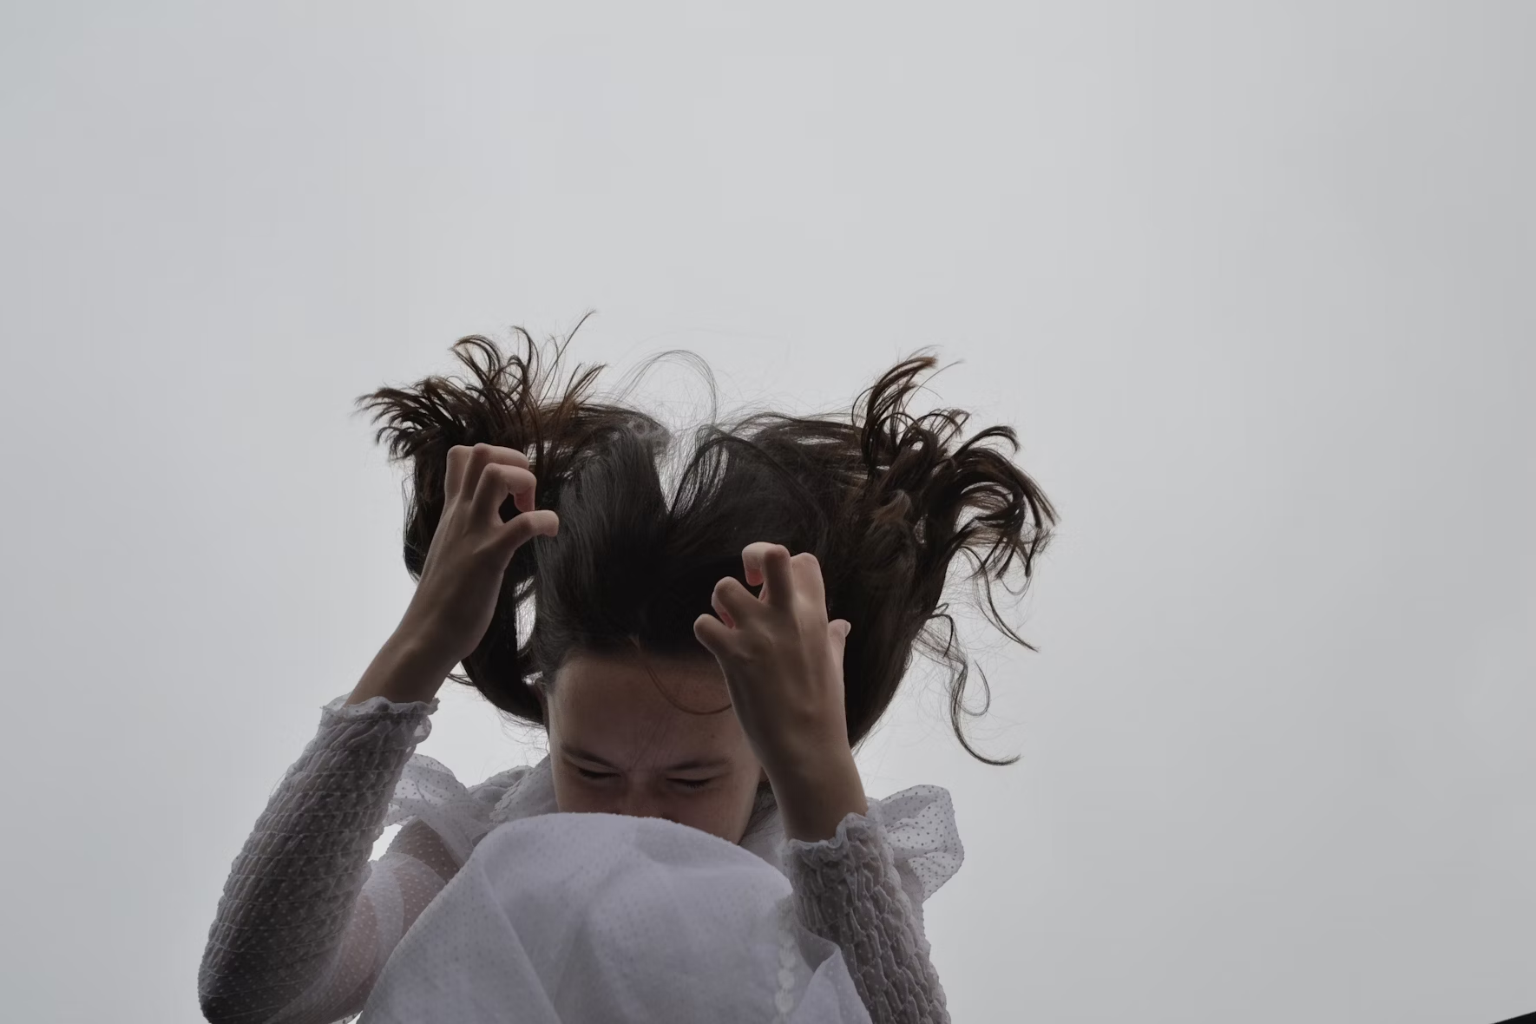
Notes:
https://unsplash.com/photos/woman-in-white-long-sleeve-shirt-covering-her-face-with-her-hair-B5mSY_Nx4GE
我開始擔心起自己能否做好份內工作。

Slide 10

3.努力
Notes:
https://unsplash.com/photos/a-man-sitting-at-a-desk-working-on-a-laptop-C_odhHJqA-A
於是我更加努力，

Slide 11
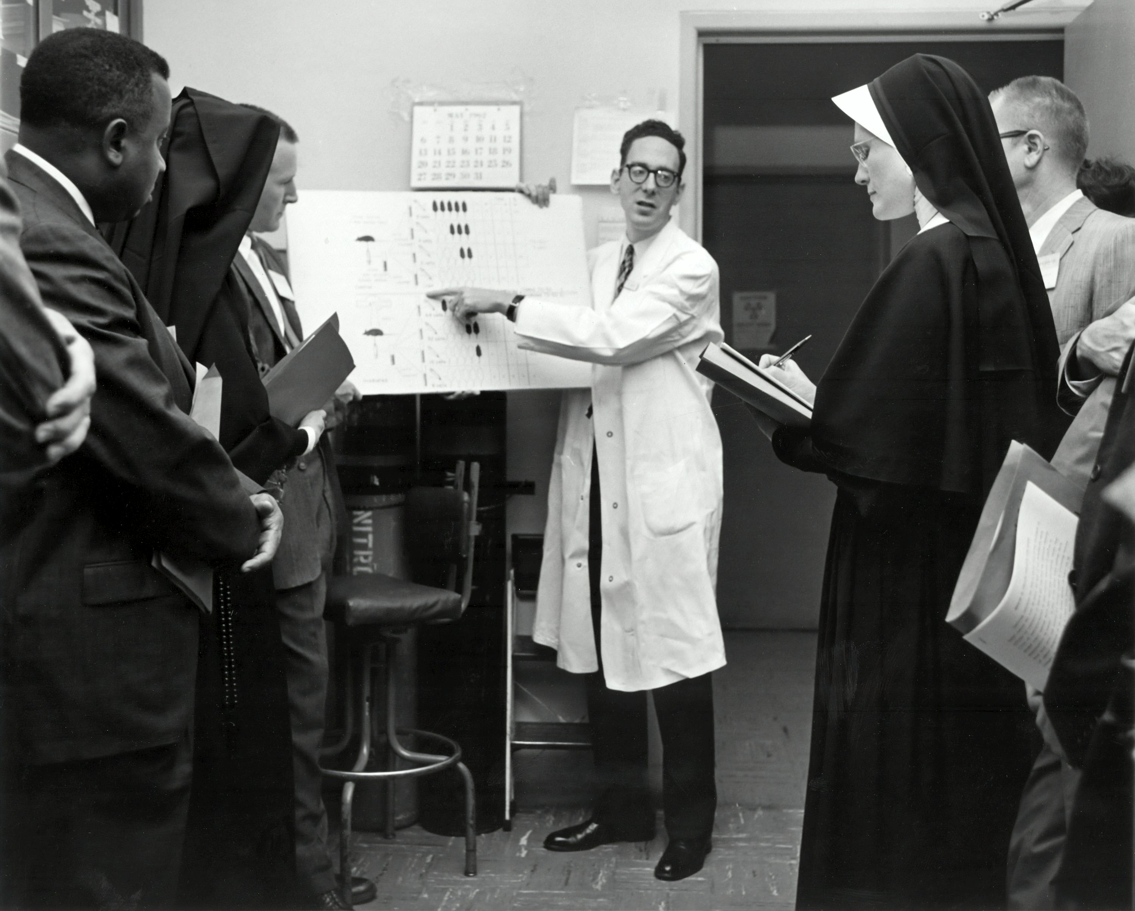
Notes:
https://unsplash.com/photos/greyscale-photography-of-people-mAm4G26iQGU
白天跟著前輩實習

Slide 12

Notes:
https://unsplash.com/photos/person-writing-on-white-notebook-LtNvQHdKkmw
晚上繼續抱著電腦學習

Slide 13

4.結果
Notes:
https://unsplash.com/photos/a-man-standing-on-top-of-a-cliff-with-his-arms-in-the-air-ncMnp3nXJvo
最終，

Slide 14

Notes:
https://unsplash.com/photos/asian-young-female-doctor-in-white-gown-with-stethoscope-in-office-o6Y4C5xM_gU
我發現我面對一些突發的小情況，已經能夠妥善處理，不再緊張

Slide 15

5.意外
Notes:
https://unsplash.com/photos/a-night-view-of-a-city-with-a-lot-of-tall-buildings-x1-4c42c8k4
然而就在一天夜晚，

Slide 16
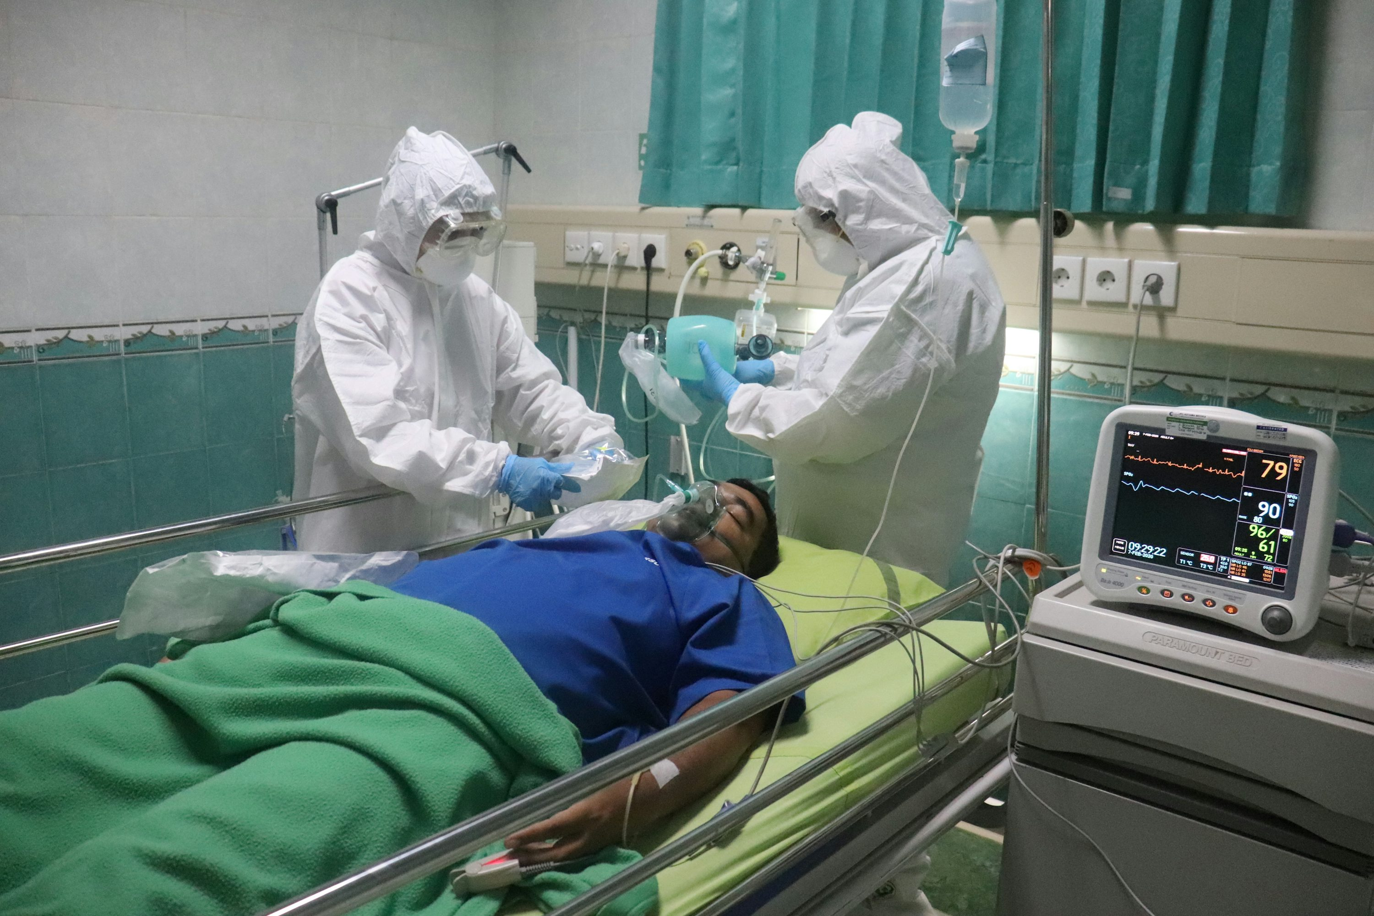
Notes:
https://unsplash.com/photos/man-in-white-medical-scrub-lying-on-hospital-bed-J12RfFH-2ZE
一位心臟病發的患者被緊急送進急診室，

Slide 17
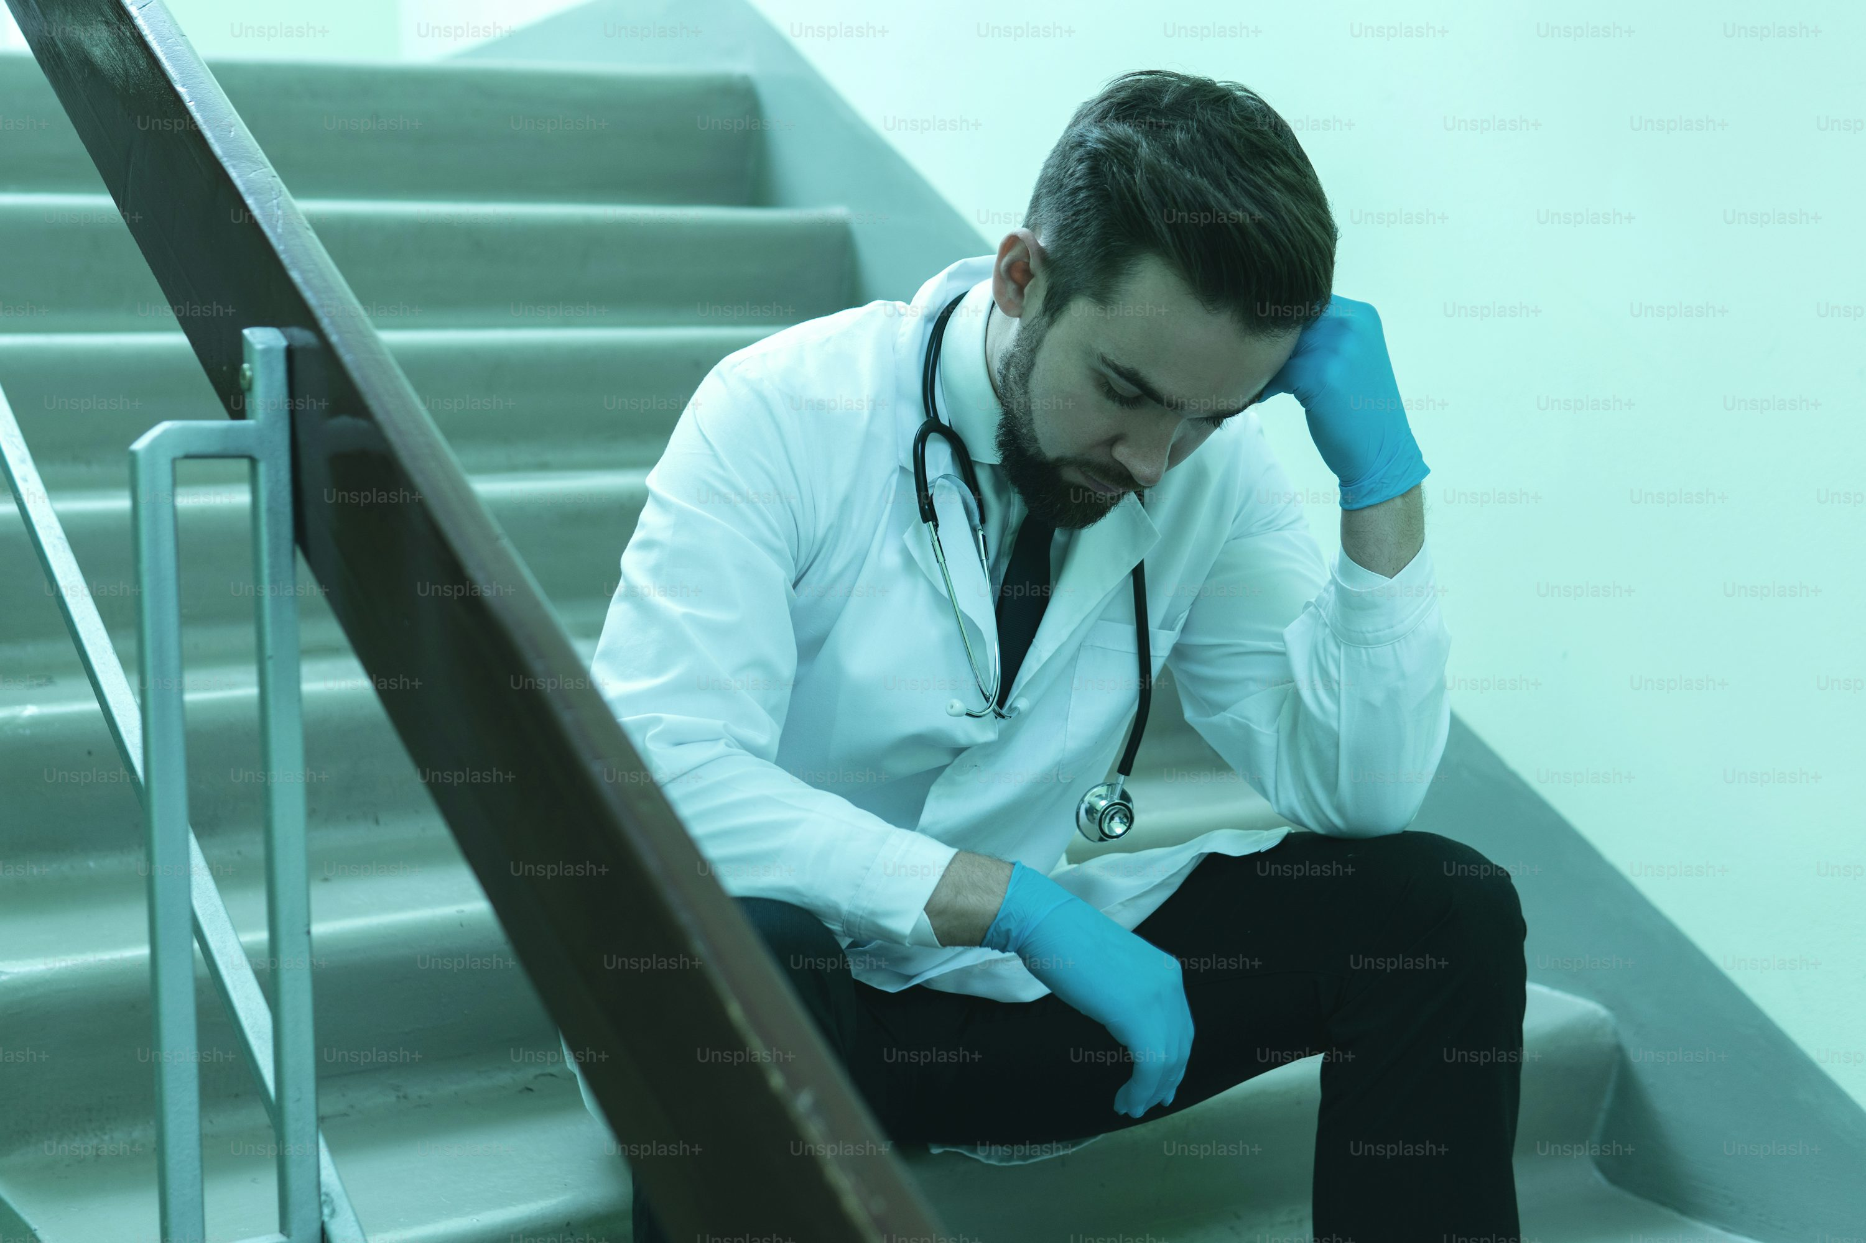
Notes:
https://unsplash.com/photos/exhausted-doctor-after-very-long-shift-in-the-hospital-dKWAjrJ_7ok
當時沒有其他醫生在場，只能由我跟護士啟動急救程序。面對這樣的壓力，我不禁又緊張起來，手心冒著冷汗。

Slide 18

Notes:
https://unsplash.com/photos/round-timex-analog-clock-at-233-eIkbSc3SDtI
此時每分每秒都顯得格外漫長。

Slide 19
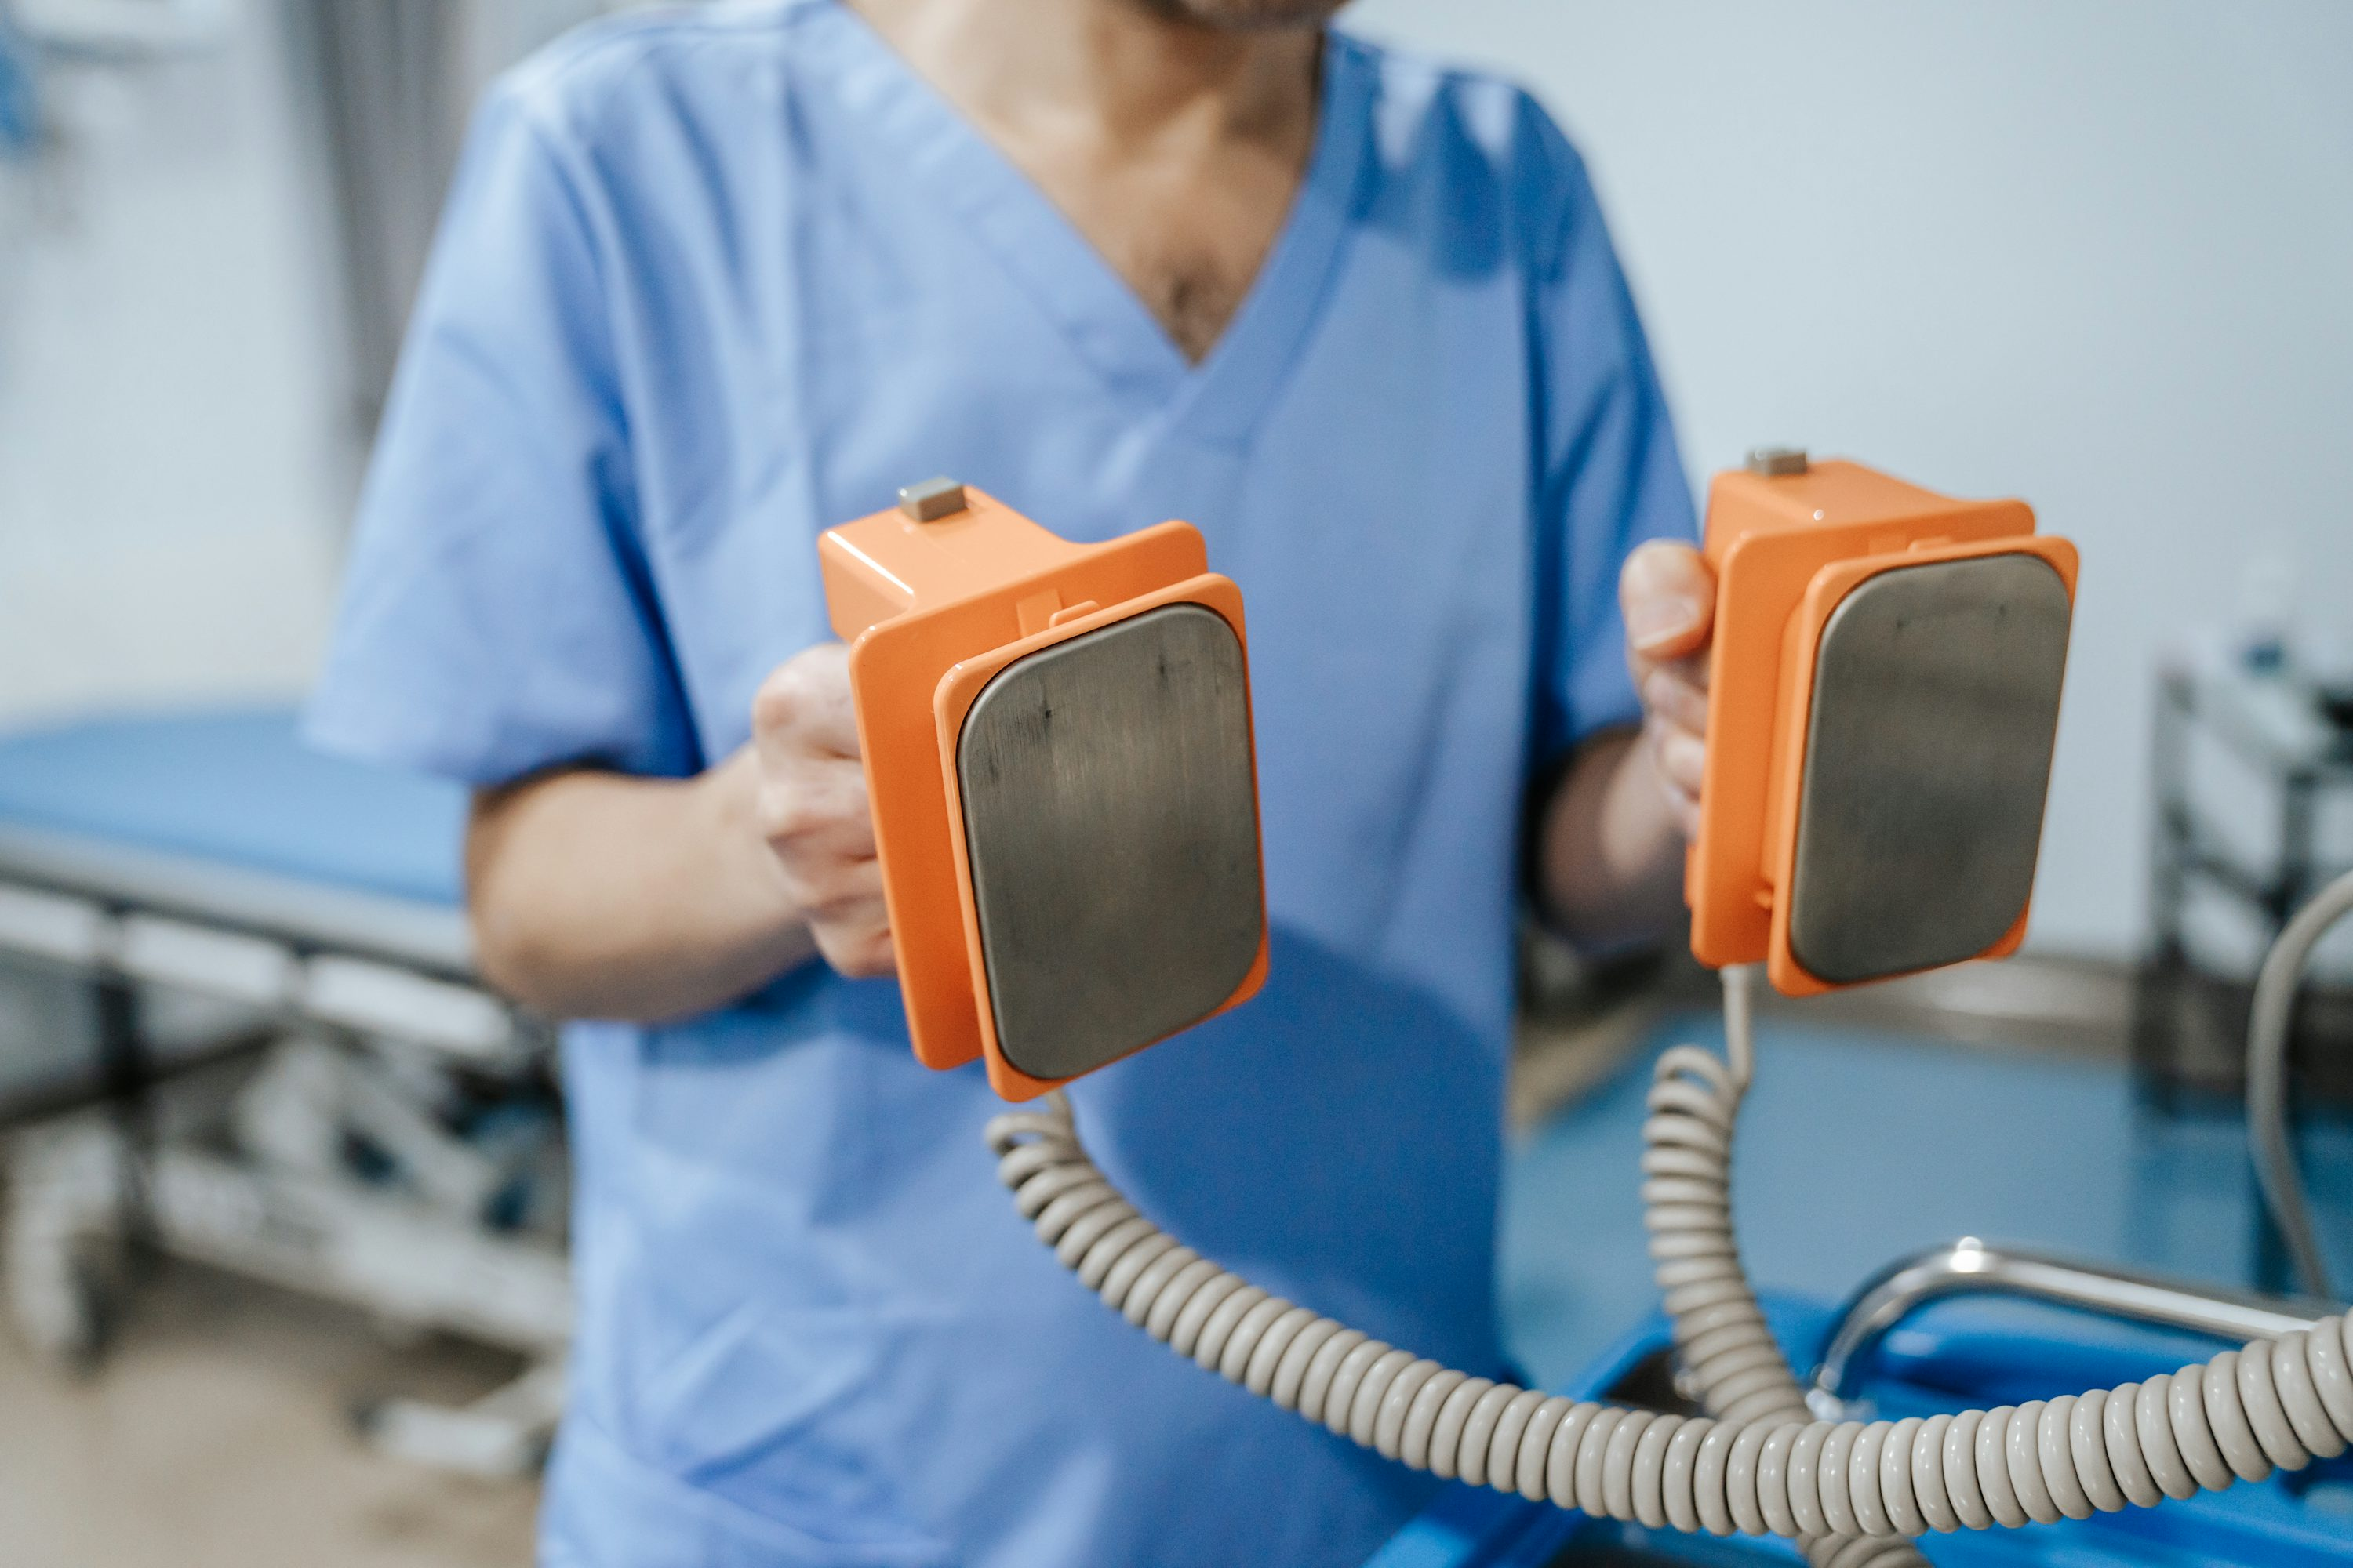
6.轉彎
Notes:
https://unsplash.com/photos/a-man-in-scrubs-is-holding-two-orange-objects-8SFwqmmQXec
正當我準備使用除顫器時，

Slide 20
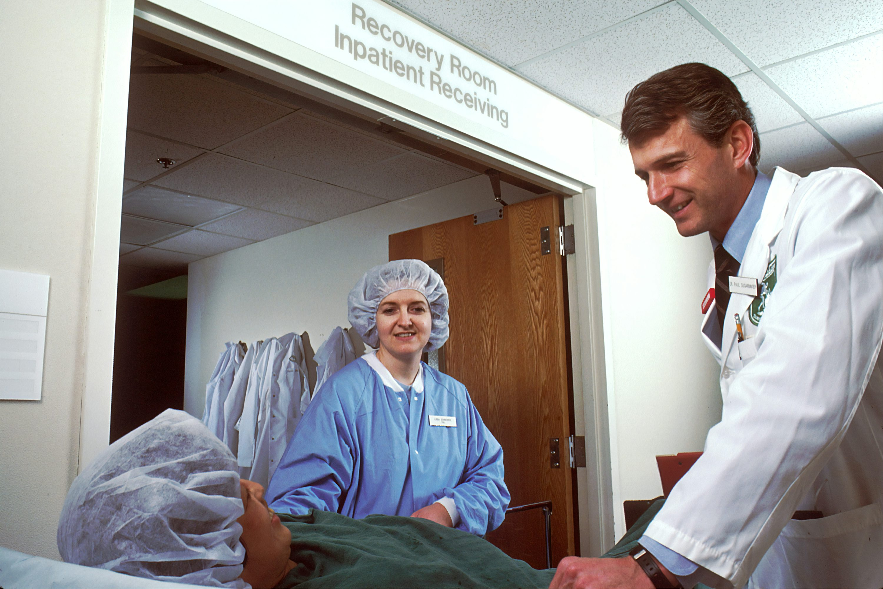
Notes:
https://unsplash.com/photos/woman-in-blue-scrub-suit-standing-beside-woman-in-white-robe-oM3o8sWsOOk
主治醫師匆忙趕到，接手了治療。

Slide 21

7.結局
Notes:
https://unsplash.com/photos/a-woman-sitting-on-a-bed-with-a-tattoo-on-her-arm-RIoIBsr6P38
儘管我認為自己面對這樣危機的處置有很大的改進空間，

Slide 22
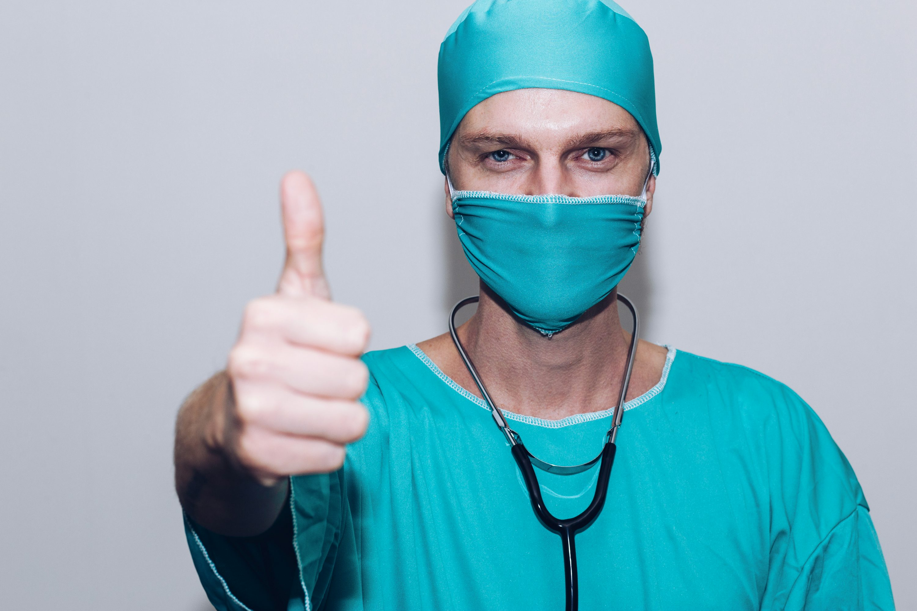
Notes:
https://unsplash.com/photos/person-in-green-crew-neck-long-sleeve-shirt-wearing-blue-face-mask-38Un6Oi5beE
主治醫師仍誇讚我面對這樣的情況能冷靜處理是成為一個優良醫師的重要特質

Slide 23
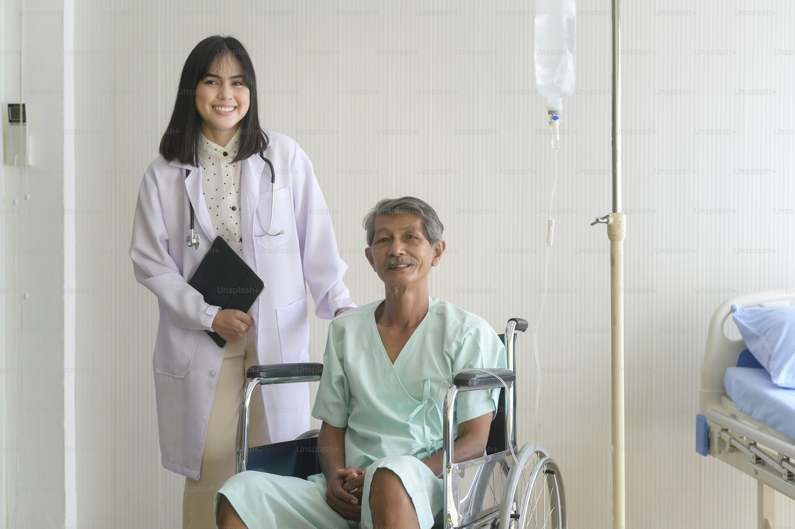
Notes:
https://unsplash.com/photos/doctor-helping-senior-patient-man-moving-to-wheelchairs-at-hospital-health-care-and-medical-concept-7RcMbukMJP4
他的誇讚給了我信心，讓我更有勇氣面對未來的挑戰。

